Slide 1
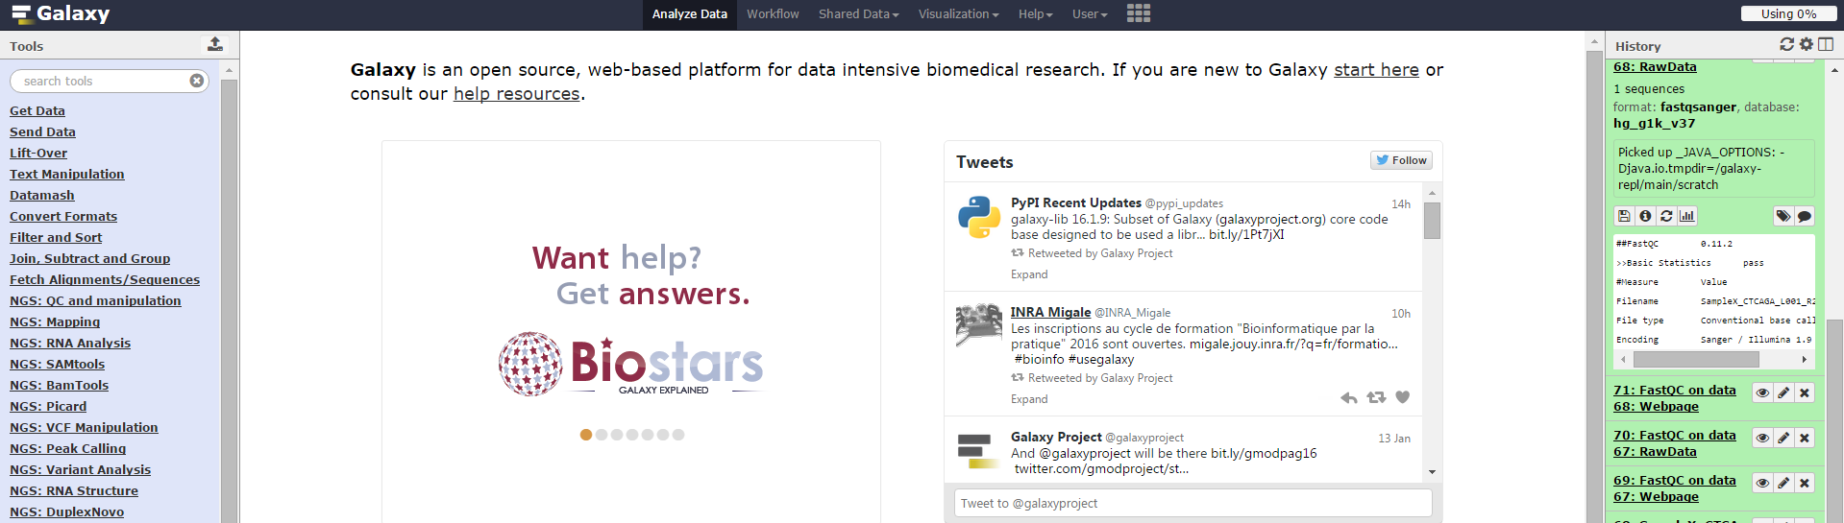
Introduction to the
ExAC browser & Galaxy
The First steps
https://galaxyproject.org
The ExAC browser
Using Galaxy to:
Get the data
Lift over
Text manipulation
Filter and sort
Statistics
Introduction to Galaxy – January 2017 – Eran Elhaik

Slide 2
The Agenda
The goals of this session are:
1) To introduce you to the ExAC browser.
2) To encourage you to explore on your own how Galaxy can help you perform genomic analysis.

Slide 3
The ExAC browser
The Exome Aggregation Consortium (ExAC) dataset in http://exac.broadinstitute.org/ spans 60,706 unrelated individuals sequenced as part of various disease-specific and population genetic studies. The dataset serves as a useful reference set of allele frequencies for severe disease studies. All of the raw data from these projects have been reprocessed through the same pipeline, and jointly variant-called to increase consistency across projects.
Note, the ExAC browser is a simple tool that a allows visualizing genes, SNPs, and transcripts. It cannot be used to perform complex analysis. You can use it to quickly access genetic data and to validate information retrieved from other tools like Galaxy.
Notes:
Although the aforementioned proteins are responsible for the production of melanin, once it has been produced in the melanosomes, other proteins are responsible for melanin maturation. Membrane-associated transporter protein and p protein oculocutaneous albinism II (OCA2) transport melanosomes for melanin maturation. Melanocortin 1 receptor (MC1R) instructs a melanocyte to switch production between eumelanin and pheomelanin.^{3, 4, 5} Therefore, these two proteins affect the quality and quantity of the melanin in the cell. Other very minor genes are responsible for eye color production, such as agouti signaling protein, but they usually have miniscule effects.⁵
http://www.nature.com/jhg/journal/v56/n1/full/jhg2010126a.html

Slide 4
Exercise I
Practice using the ExAC browser.
Answer the following questions
Examine the MC1R, HERC2, and OCA2 genes.
How many transcripts each one has?
Which gene has the most Synonymous variants?
Which gene has the most LoF variants?
Which gene has the most stop gained LoF variants?
What is the role of these genes?

Slide 5
Exercise II
Use Galaxy to answer the following questions:
How many SNPs exist in the gene DYRK1A?
Count the number of SNPs in the gene DYRK1A using the ExAC browser and compare them to your results. Are the results similar? Why or Why not?
3) Reproduce our analyses, share it, and repeat it for the PCSK9 gene. How many SNPs does it have?
If you need help getting started, continue to slides #6-12. Note, that the proposed solution is not ideal. It was devised to help you explore the options in Galaxy rather than give you the shortest route to the answer.
A short solution to the question is in slides #13-14.
We suggest that you try to do it on your own before reading further.

Slide 6
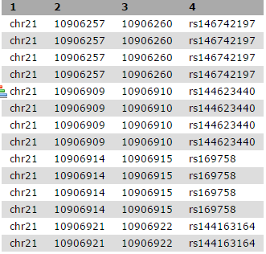
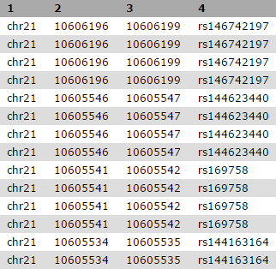
One way to answer the question…
• Get all coding SNPs for chromosome 21 of human (HG 19) → UCSC Table Browser.
Lift over hg19->hg 38

Slide 7
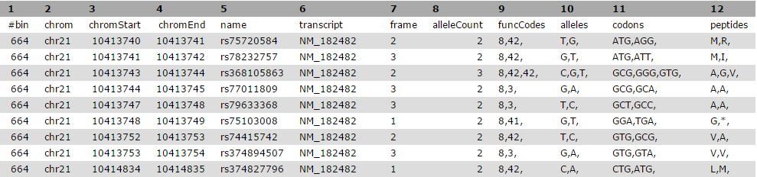
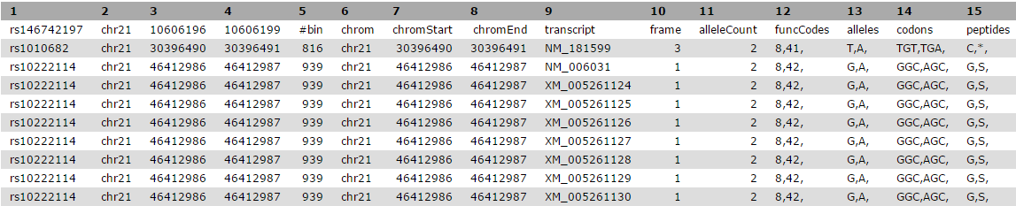
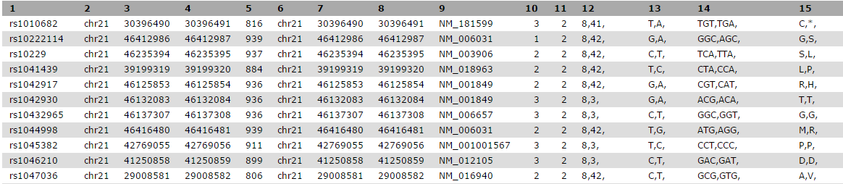
• Get functional annotation for all the SNPs
Annotate your original SNPs using the annotation you obtained (Join tables)
Save only the unique SNPs

Slide 8
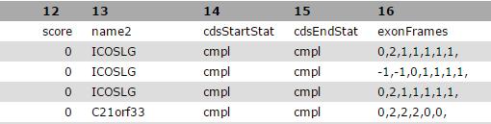
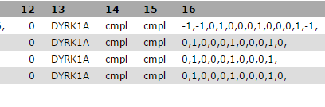
• Find all the SNPs in the DYRK1A gene.
You can download all the genes that are in chromosome 21 (should you use 21 or chr21?). You can also download just… what?
Get the gene of interest (Why #2 has different names?)
Notes:
NM_001396

Slide 9
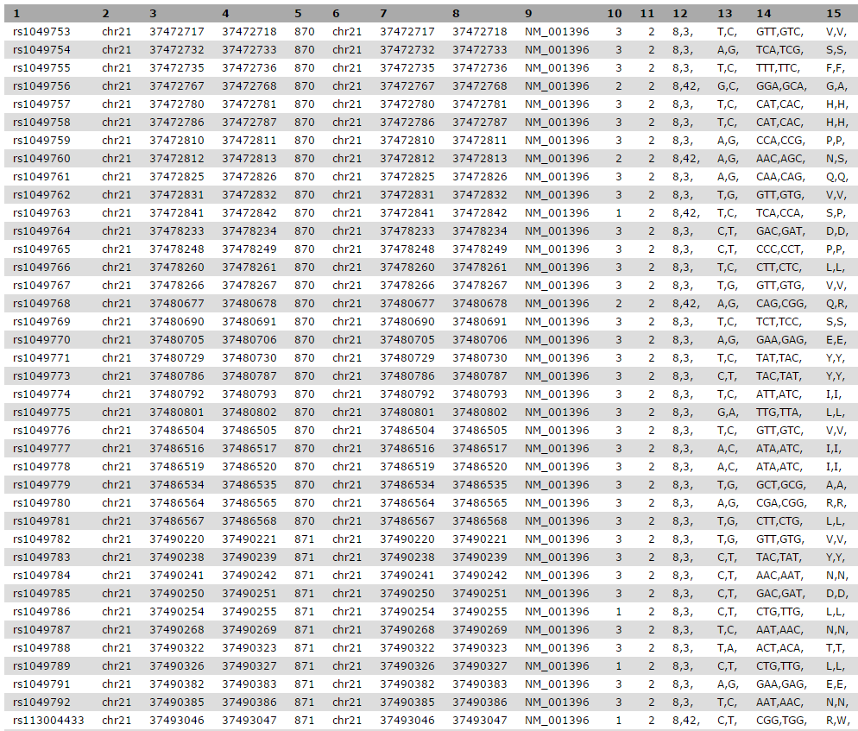
Find the SNPs harbored in DYRK1A (filter to get positions)

Slide 10
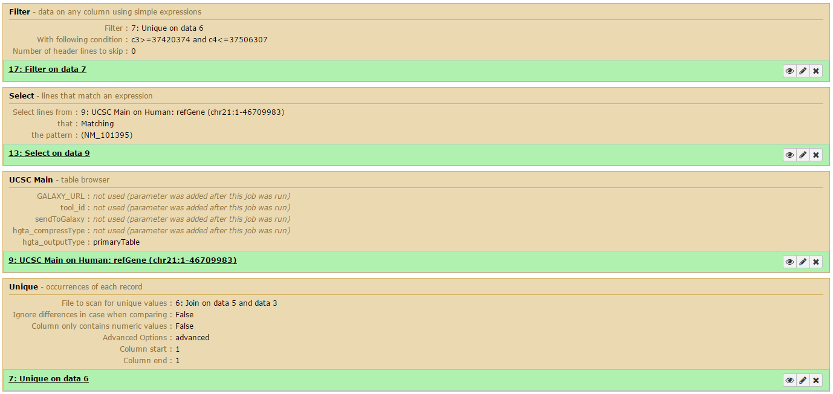
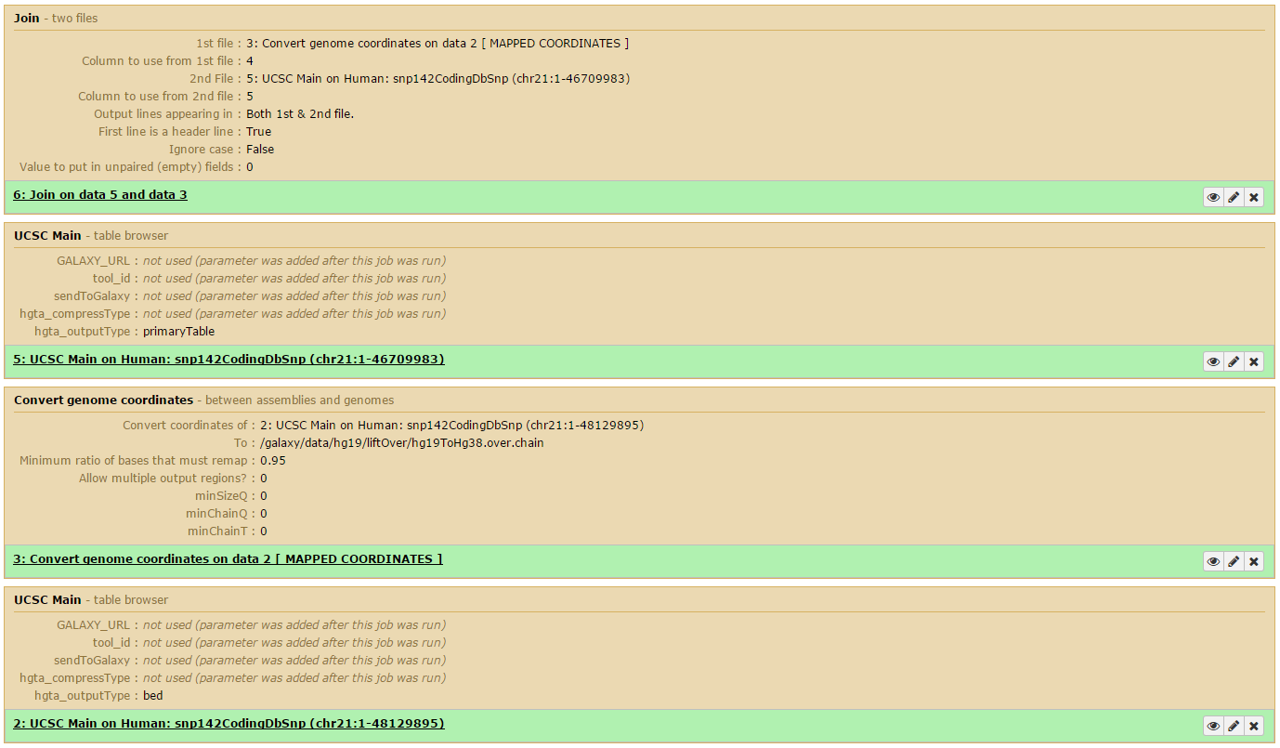
A proposed
workflow

Slide 11

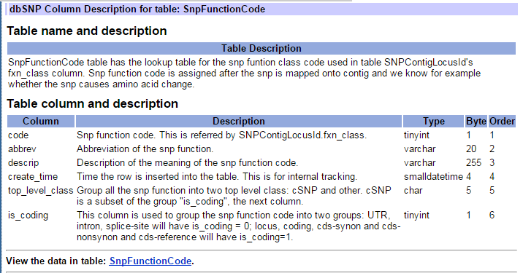
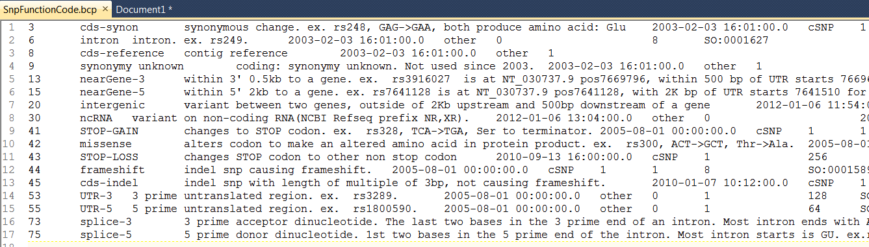
Count the occurrence of functional SNPs in this gene
Find the table that interprets these codes
http://www.ncbi.nlm.nih.gov/projects/SNP/
http://www.ncbi.nlm.nih.gov/SNP/snp_db_table_description.cgi?t=SnpFunctionCode

Slide 12
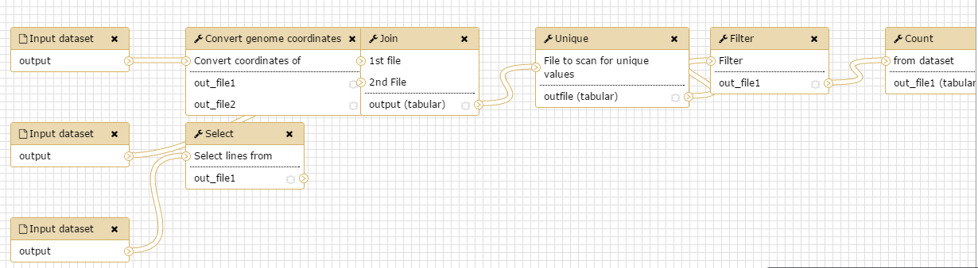
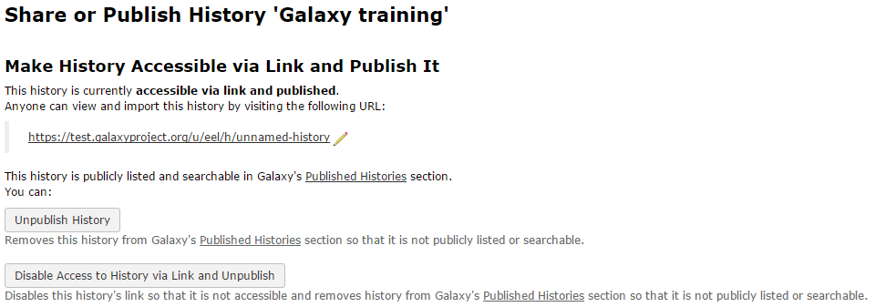
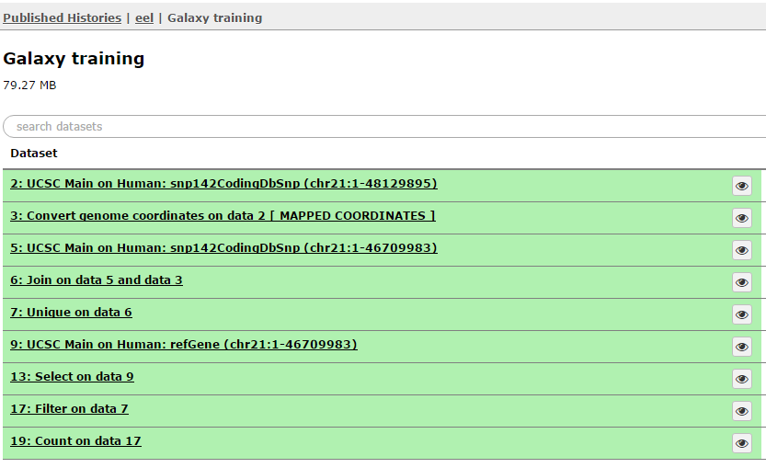
Save your workflow
https://test.galaxyproject.org/u/eel/h/unnamed-history
Publish your workflow and history

Slide 13
Another way to do that…
• Get the exact positions of the gene from UCSC Browser/ExAC
Download all the SNPs between these coordinates (snp144CodingDbSnp)
Filter data by one of the transcripts
Count the SNPs
The next slide would show you exactly how to do that. But once again, we suggest that you try to do it on your own before reading further.

Slide 14
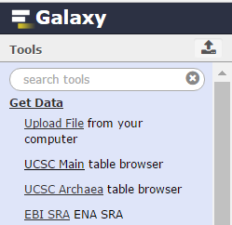
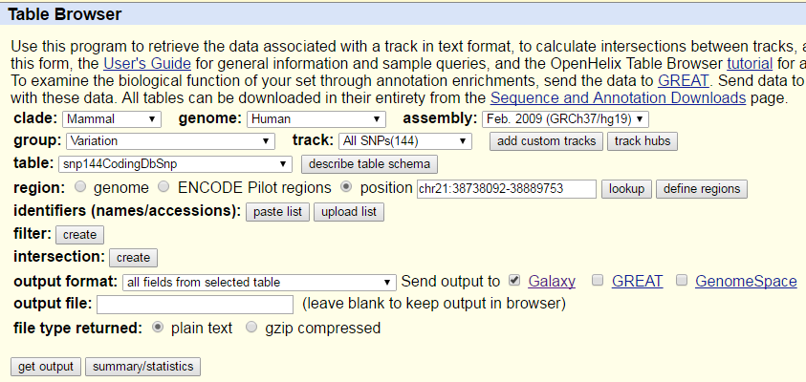
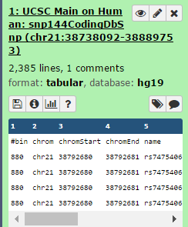
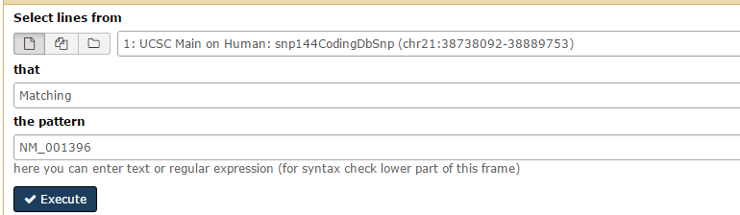
Detailed instructions
Pick one transcript:
NM_001396.
Filter and sort -> Select

